Slide 1
Nakuja Internship
Avionics Progress report Edwin Mwiti Junn Hope

Slide 2
Tasks completed last week
[#Issue 4] : Getting acquainted with Avionics and Telemetry resources
Onboarding and task planning
Flight computer 2 review

Slide 3
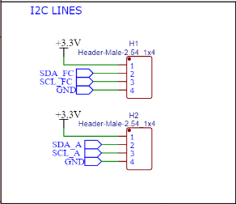
COMMUNICATION CHANNELS
I2C Communication
Avionics board
Flight control board
Flight control board
Telemetry
Avionics board
i2c
Lora/Wifi
Ground station

Slide 4
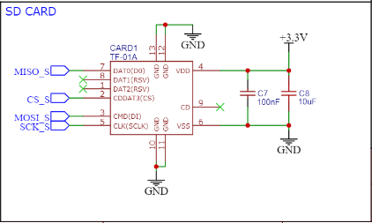
STORAGE
SD CARD MODULE
Post flight analysis data
-velocity
-acceleration
-gyroscope(orientation)
-altitude data

Slide 5
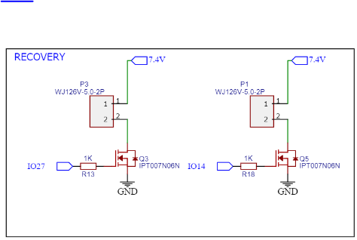
Flight recovery
Flight recovery system:
Parachute deployment
esp32 ~ 140mA
mosfet ~ 2A

Slide 6
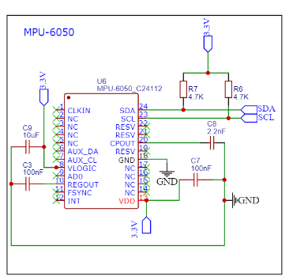
Motion Tracking(MPU6050)
Flight motion tracking:
Gyroscope
Accelerometer

Slide 7
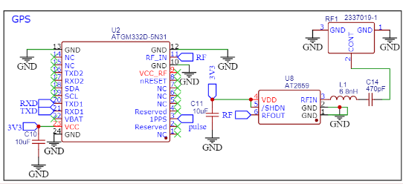
Flight Navigation
GPS System
Transmit real-time location data to ground station
For recovery

Slide 8
Tasks in this week
[#Issue 1] : Research on data transmission (lora vs wifi)
parameters: 1km > upload speed 272.16 kbps
[#Issue 2] : Research on ground station
parameters: 1km > download speed 1000 kbps
[#Issue 3] : Research on ground station dashboard-Grafana
[#Issue 30]: Research on camera module

Slide 9
Timeline
Month | Intern week | Tasks
Jan | Week 1 | Onboarding Getting acquainted with avionics and telemetry resources
 | Week 2 | Research on ground station & ground station dashboard Research on camera module Research on Data transmission
 | Week 3 | Avionics bay design Launch pad design
Feb | Week 4 | Research on apogee detection logic Improve Kalman filter performance
 | Week 5 | Program Avionics and Telemetry boards
 | Week 6 | Test the boards
 | Week 7 | Testing and launch of N2

